Slide 1
Bio& 242 A&P
Unit 4 / Lecture 4

Slide 2
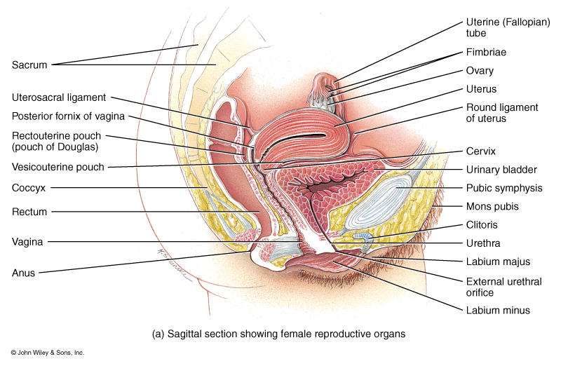
Anatomy of the Female
Reproductive System

Slide 3
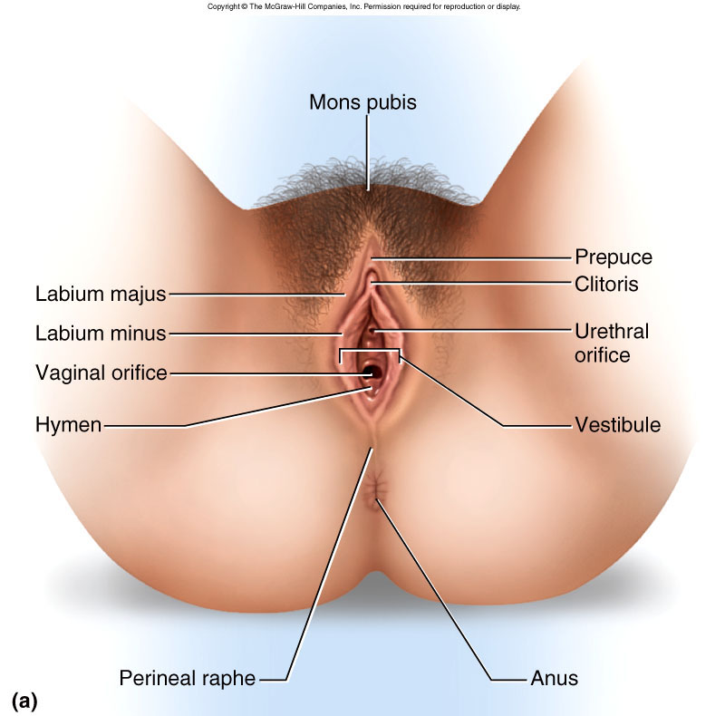
Female Vulva

Slide 4
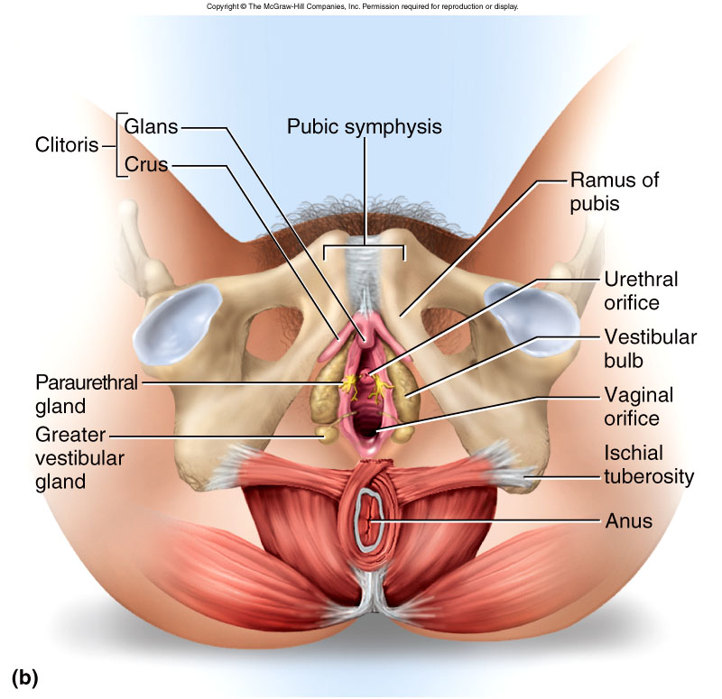
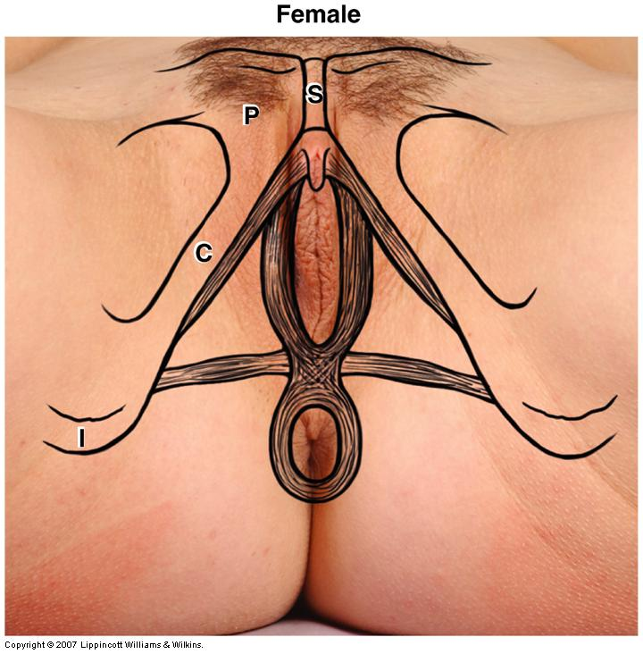
Female Vulva

Slide 5
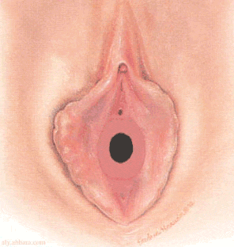
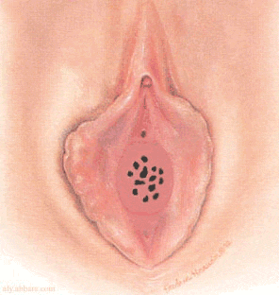
Female Hymen
annular hymen
rare cribriform hymen

Slide 6
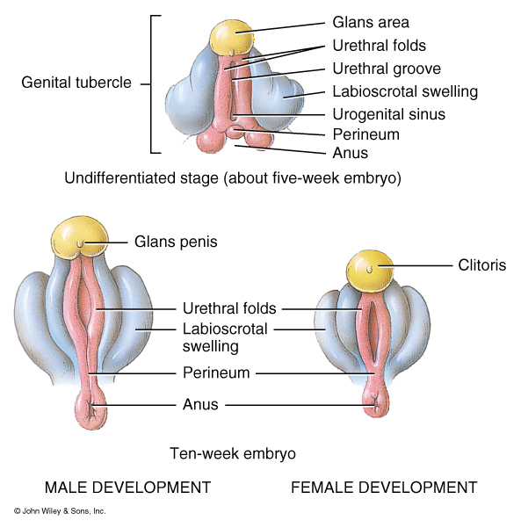
Development of Genitalia and related structures

Slide 7
Development of Genitalia and related structures
Urogenital Sinus
Male Female
Prostate Gland Urethral/paraurethral gland
Bulbourethal glands Greater Vestibular Glands
Phallus
Glans Penis Glans Clitoris
Corpora Cavernosa penis Corpora Cavernosa clitoris
Corpus Spongiosum Bulb of the vestibule
Ventral aspect of Penis Labia Minora
Scrotum Labia Majora

Slide 8
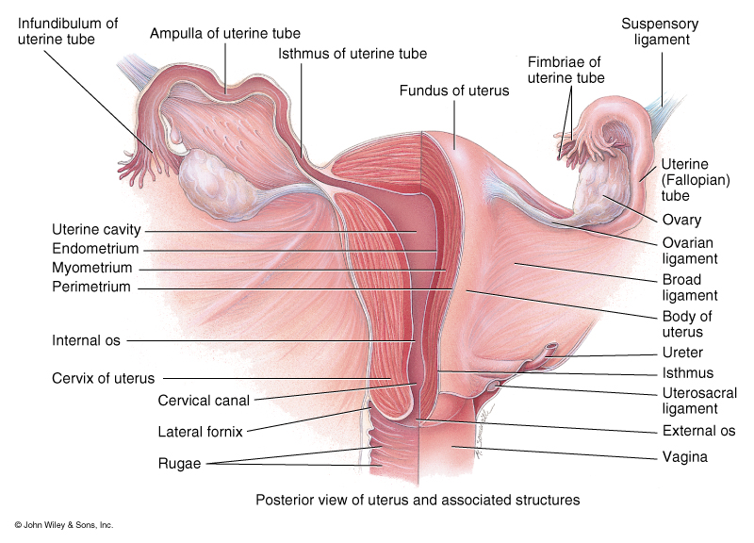
Internal Anatomy of the Female Reproductive System

Slide 9
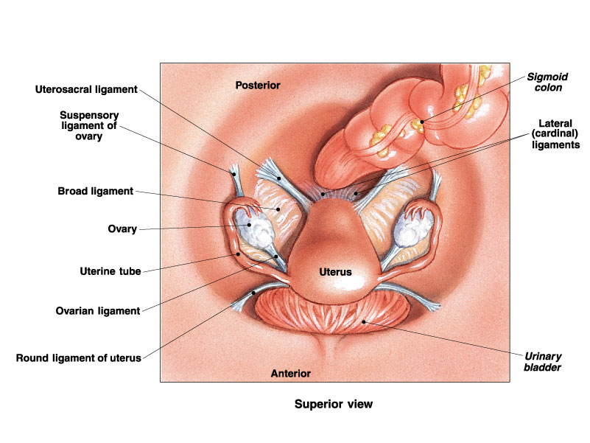
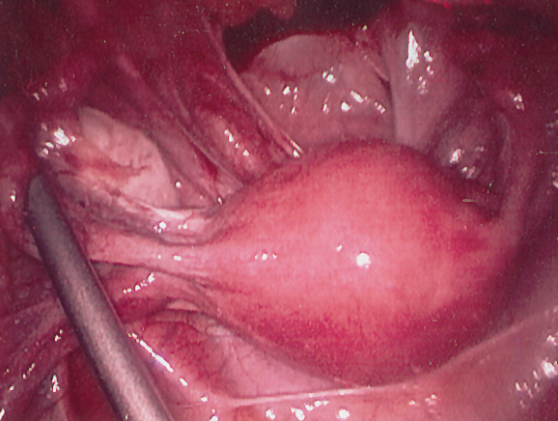
Internal Anatomy of the Female Reproductive System

Slide 10
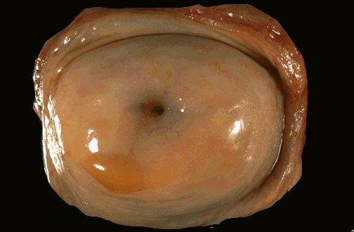
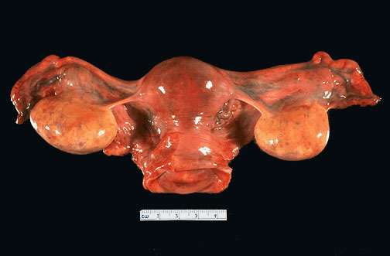
Internal Anatomy of the Female Reproductive System, gross view

Slide 11
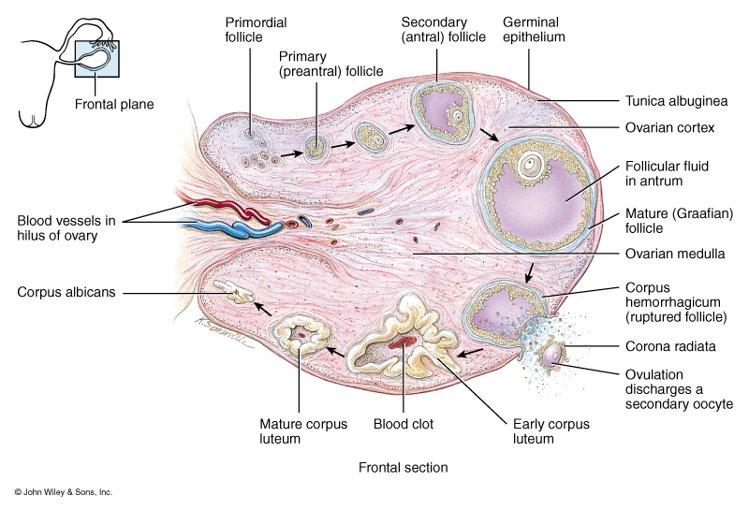
Steps of Oogenesis
Primordial Follicles:
during fetal development, oogonia develop from mitosis of stem cells. These cells start through meiosis, however, meiosis is stopped at prophase meiosis I.
In adult ovaries, primordial follicles contain a primary oocyte.

Slide 12
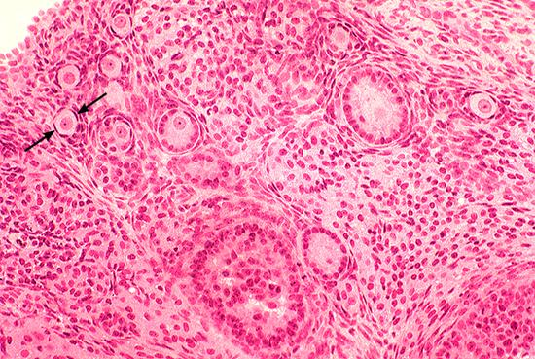
Steps of Oogenesis
Primordial Follicles:
Arrows indicate a primordial follicle

Slide 13
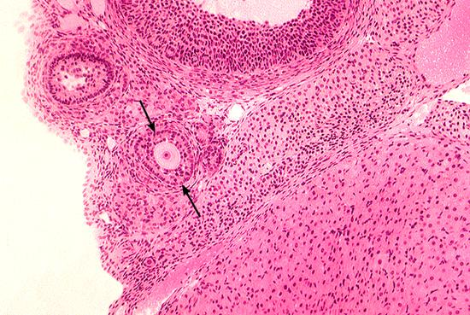
Steps of Oogenesis
Primary follicle: After puberty, due to increasing levels of FSH, primary follicular cells enlarge and begin secreting estrogen. In humans, the estrogen inhibits other follicles and their primary oocyte from developing.

Slide 14
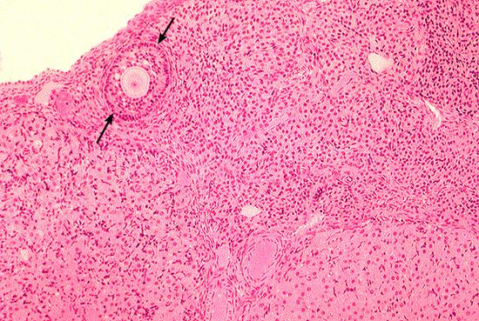
Steps of Oogenesis
Secondary Follicle: The diploid primary oocyte undergoes meiosis I and gives rise to one haploid secondary oocyte and one polar body. Several primary oocytes within several secondary follicles may start this process but usually only one completes the process.

Slide 15
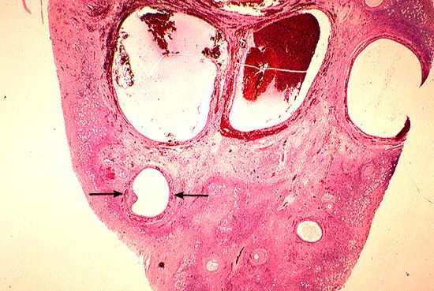
Steps of Oogenesis
Graafian follicle: contains a haploid secondary oocyte and the first polar body. Due a surge of LH, the secondary oocyte is ovulated before meiosis II occurs.

Slide 16
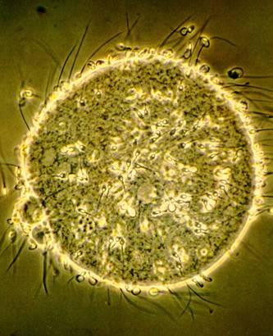
Steps of Oogenesis
The Ovum forms from meiosis II after a sperm cell has contacted the secondary oocyte.
In the picture, you can see sperm cells surrounding the oocyte and both polar bodies indicating meiosis II has occurred.

Slide 17
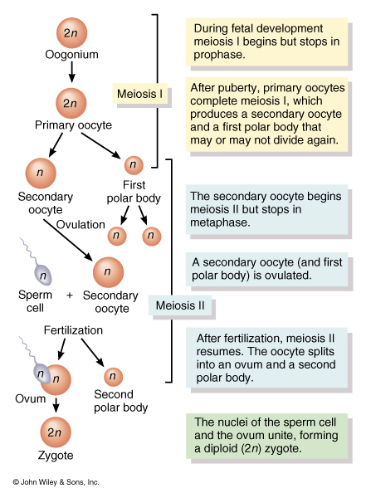
Review of Oogenesis

Slide 18
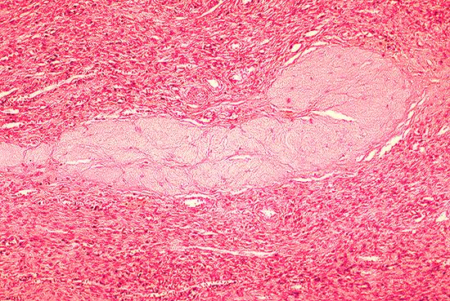
Formation of the Corpus Luteum
After ovulation, the follicular cells implode forming the Corpus Luteum.
The Corpus Luteum produces high amount of progesterone and smaller amounts of estrogen, relaxin and inhibin.

Slide 19
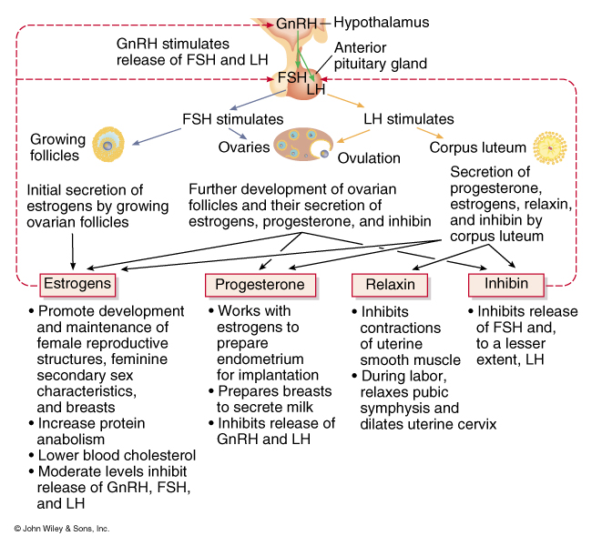
Hormones Involved in an Ovarian Cycle

Slide 20
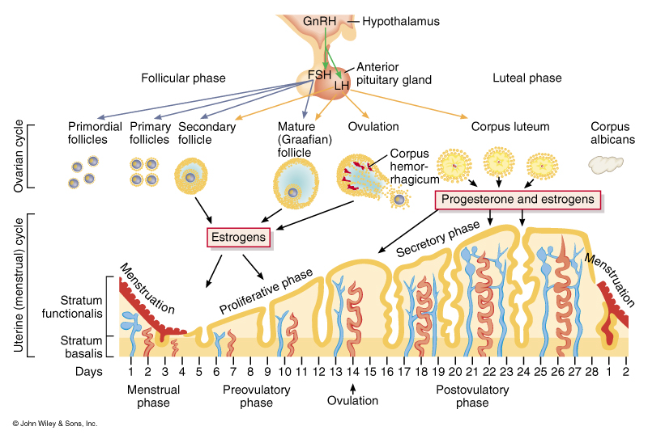
Action of Hormones on the Ovaries and Uterus

Slide 21
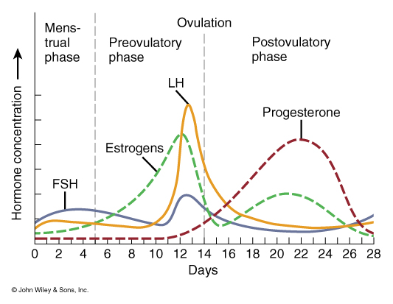
Cyclic Patterns of Hormone Production during the Ovarain Cycle

Slide 22
Terms associated with the Ovarian Cycle
Menses: Monthly Blood Flow
Amenorrhea: Without periods
Dysmenorrhea: Painful periods
Menarche: First period
Menopause: Cessation of periods, usually between 40 to 55.

Slide 23
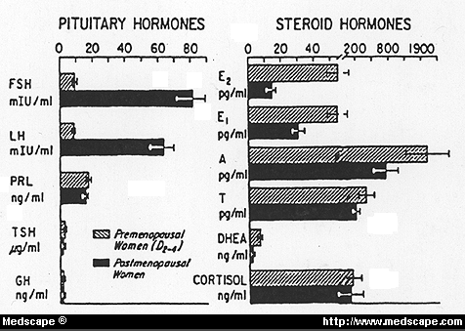
Menopause
Hormonal Changes during Menopause
Blood levels of FSH increase
Blood levels of Inhibin decrease
Blood levels of estradiol decrease
Blood levels of progesterone decrease
Blood levels of DHEA decrease

Slide 24
Menopause
The degree to which each woman’s body responds to these normal hormonal changes varies.
25% of women do not have any problems with menopause and manage the transition without assistance
50% of women experience some menopausal symptoms, varying from mild to moderate
25% of women have more severe problems
Common Menopausal Symptoms:;
1. Hot flushes (last 30sec to 5min)
2. Menstrual irregularities
3. Sleep disturbances
4. Genital changes
5. Urinary problems
6. Joint/muscle aches and pain
7. Skin /hair changes
8. Neurological Brain function changes

Slide 25
Menopause
Positive action to decrease symptoms
1. Eat a well balanced diet
2. Exercise regularly
3. Stress management (Tai chi, yoga, meditation, relaxation)
4. Making sex comfortable (water based lubricants, vaginal hormone therapy)
5. Pelvic floor exercises
6. Trial hormone replacement therapy
7. Quit smoking

Slide 26
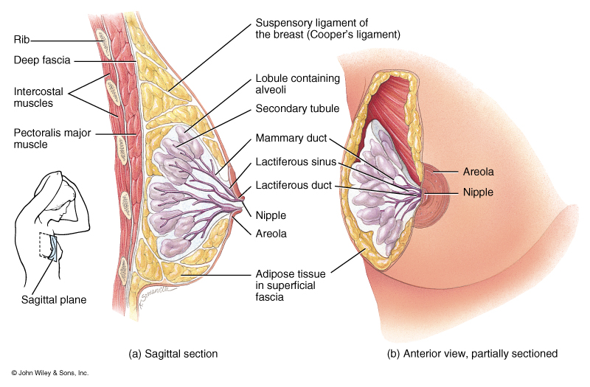
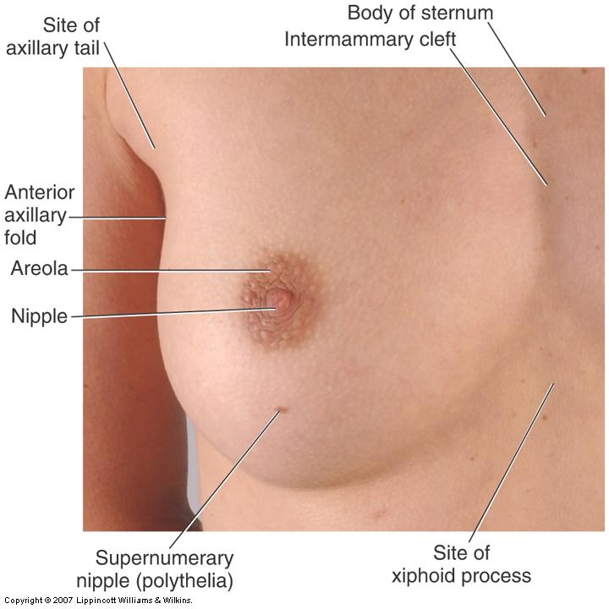
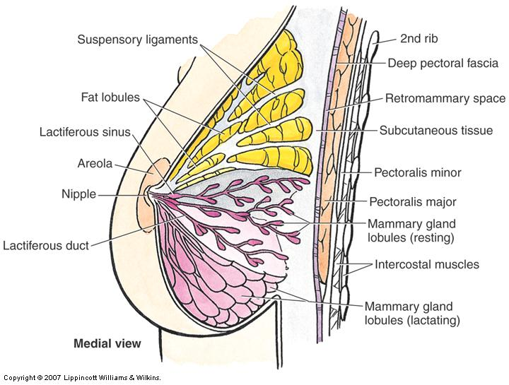
Anatomy of the Breast

Slide 27
Inverted Nipples
A nipple that, instead of
pointing outward, is retracted
into the breast. In some cases,
the nipple will be temporarily
protruded if stimulated, but in
others, the inversion remains
regardless of stimulus. Women
and men can have inverted
nipples.

Slide 28
Asymmetric Breast Develop

Slide 29
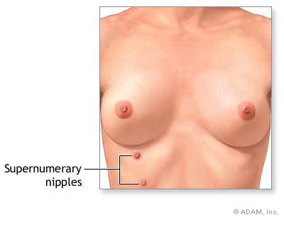
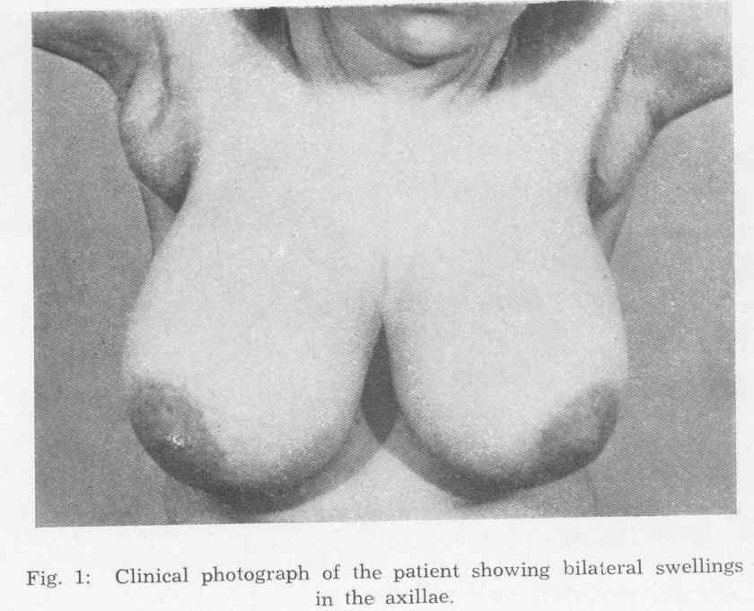
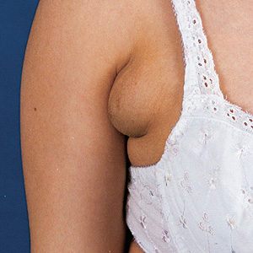
Polytheia: Extra nipples
Polymastia: Extra breast tissue usually in the axillary area. May or May not have nipples and areola.

Slide 30

Breast Cancer
Ductal carcinoma: The most common kind of breast cancer. It begins in the cells that line the m ilk ducts in the breast.
in situ (DCIS): The abnormal cancer cells are only in the lining of the milk ducts, and have not spread to other tissues in the breast.
Invasive ductal carcinoma: The abnormal cancer cells break through the ducts and spread into other parts of the breast tissue. Invasive cancer cells can also spread to other parts of the body.
Lobular carcinoma: In this kind of breast cancer, the cancer cells begin in the lobes, or lobules, of the breast.
in situ (LCIS). The cancer cells are found only in the breast lobules.
Invasive lobular carcinoma. Cancer cells spread from the lobules to the breast tissues that are close by

Slide 31
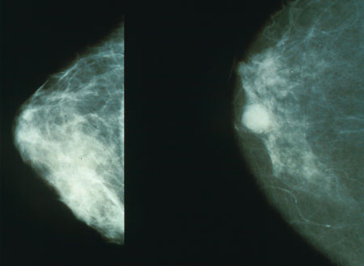
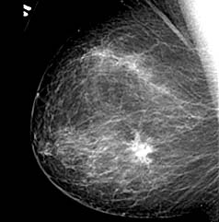
Mammogram of a normal breasts
and breast cancer
An example of obvious signs of
Inflammatory breast cancer
displaying the swollen breast,
redness, inverted nipple and
peau d'orange (orange-peel texture).

Slide 32
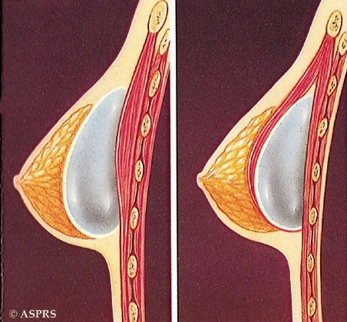
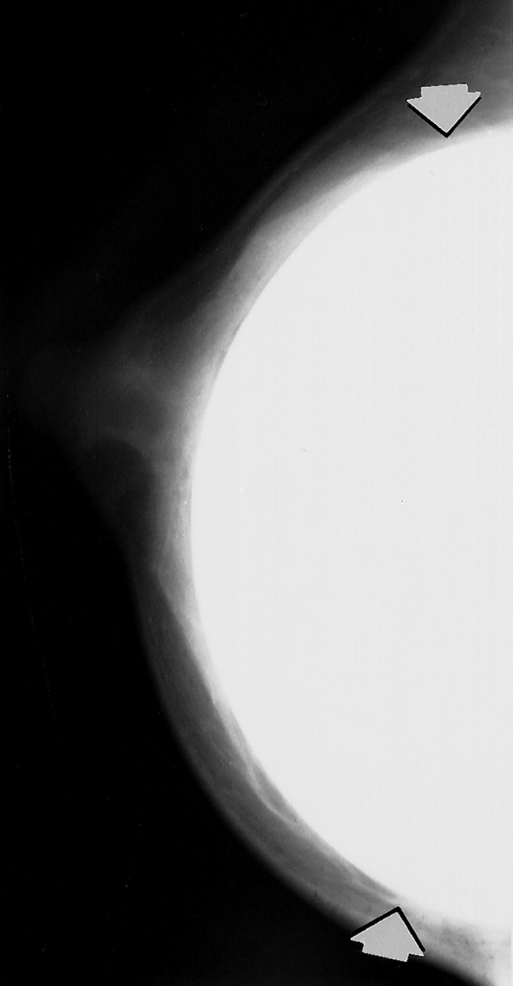
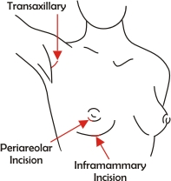
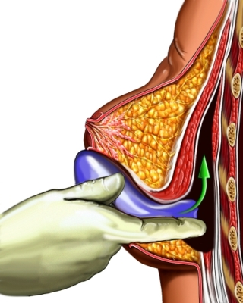
Breast Implant

Slide 33
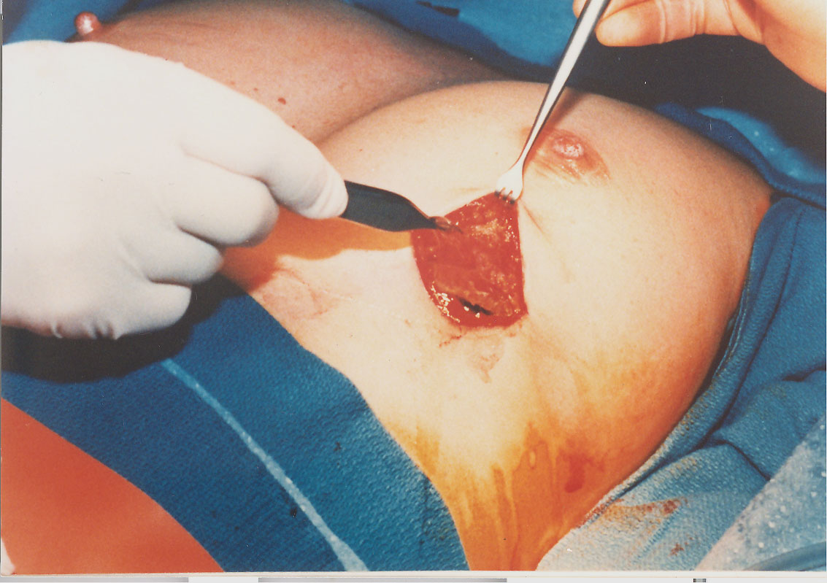
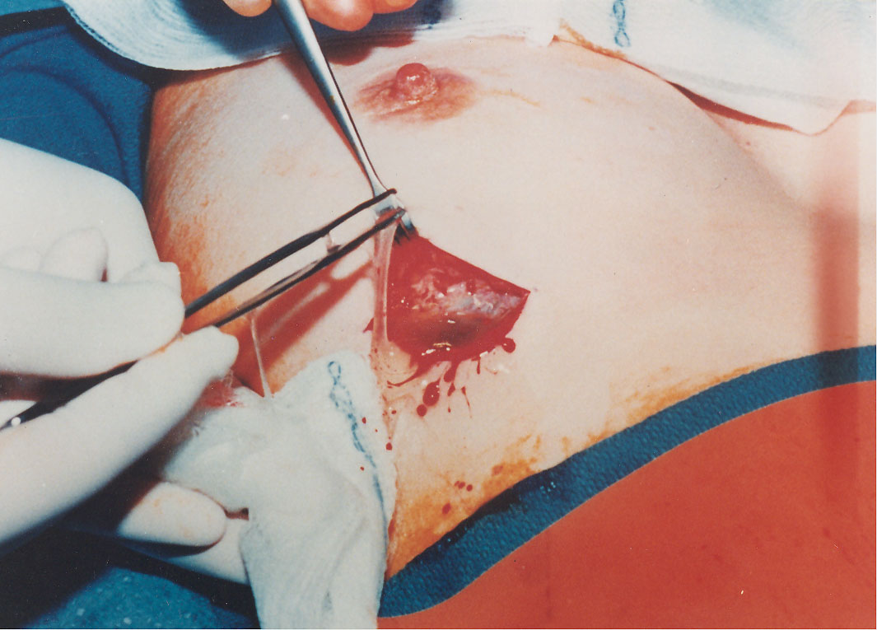
Breast Implant Removal

Slide 34
The Female Sexual Response
Arousal: various erotic thoughts and physical stimulation triggers parasympathetic reflexes that cause an erection and lubrication.
Erection: occurs when neurons release Nitric Oxide at their synaptic endings.
NO causes smooth muscles of the clitoral arteries to relax, vessels dilate, blood flow to the erectile tissue increases . The vascular channels engorge with blood, resulting pressure causes the clitoris to become stiff.

Slide 35
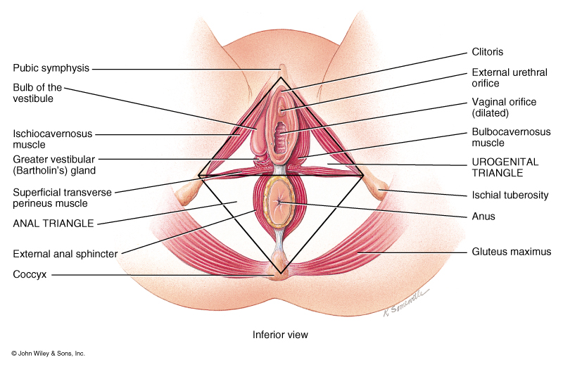
The Female Sexual Response
Blood engorgement of the labia and bulb of the vestibule cause swelling in the perineum.
Lubrication: Blood engorgement of the connective tissue of the vagina causes lubricating fluid to seep through the vaginal epithelial to cover the lumen surface. A process called “transudation.”
Greater vestibular “Bartholin’s glands also release mucus.
During arousal, increases in heart rate, blood pressure, skeletal muscle tone, and hyperventilation occur

Slide 36
The Female Sexual Response
Plateau stage: Changes that begin during arousal are sustained at an intense level, vasocongestion in the breast may cause breast to swell some and erection of the nipples.
Late in the plateau stage, pronounced vasocongestion of the distal third of the vagina causes it to swell and narrows the vaginal opening, thus increasing friction on the penis

Slide 37
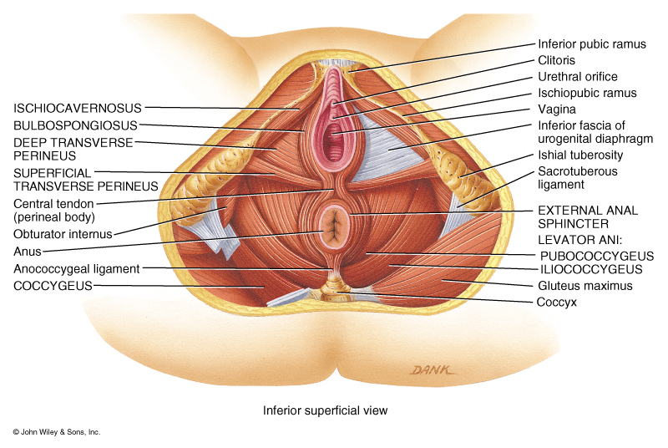
The Female Sexual Response
Orgasm; intensely pleasurable sensations associated with rhythmic contractions of smooth muscles of the vaginal wall and the uterus. Rhythmic contractions also occur with ischiocavernosus and bulbospongiosus muscles and other peritoneal muscles. Also a great increase in total body muscle tone occurs.
Other physiological changes include pronounced increase in heart rate and blood pressure.

Slide 38
The Female Sexual Response
Resolution: Sense of profound relaxation- genital tissues, heart rate, blood pressure, breathing, and muscle tone return to normal.
During early period of resolution, females lack or have a much shorter a refractory period than males. Therefore, some women can have multiple orgasms.

Slide 39
